Slide 1

TrAVELLING SALESMAN PROBLEM
(Heuristic Approaches)
Team: Almost Coders

Slide 2

Explaining the Problem
B
A
C
We ask the following Question: "Given a list of cities and the distances between each pair of cities, what is the shortest possible route that visits each city exactly once and returns to the origin city?"
Mathematically, given an undirected complete weighted graph (where the vertices are the cities, paths are the edges and the distance being the weights), find the Hamiltonian Cycle with the least weight.
F
D
E
Fig1: An arrangement of 6 cities interconnected, i.e. a K_6

Slide 3
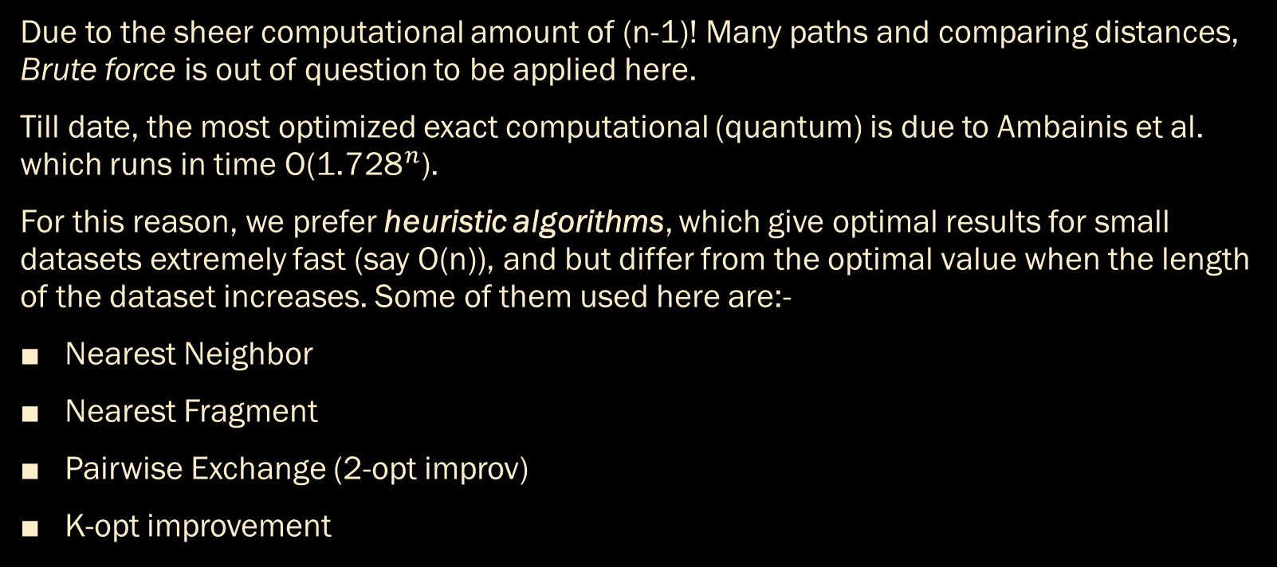
Why Heuristic?
Due to the sheer computational amount of (n-1)! Many paths and comparing distances, Brute force is out of question to be applied here.
Till date, the most optimized exact computational (quantum) is due to Ambainis et al. which runs in time O(${\text{1.728}}^{n}$).
For this reason, we prefer heuristic algorithms, which give optimal results for small datasets extremely fast (say O(n)), and but differ from the optimal value when the length of the dataset increases. Some of them used here are:-
Nearest Neighbor
Nearest Fragment
Pairwise Exchange (2-opt improv)
K-opt improvement

Slide 4
The Nearest Neighbor Heuristic Algorithm
B
3
A
2
4
C
This is a greedy algorithm where the traveller, at a point, chooses the nearest vertex among the unvisted choices he has. Choosing this recursively, he obtains a path for himself.
Here, the traveller is at A, where AB = 3, AC = 2, AD = 5, AE = 7 and AF = 4. As AC = 2 is the shortest among them all, he chooses it, travelling to C.
5
F
7
D
E

Slide 5
Nearest Neighbor Heuristic Algorithm
B
9
A
2
C
Travelling to C, he has the following choices – CB = 9, CD = 1, CE = 8 and CF = 6. Since he already visited A, that route is not considered. Among the available ones, he chooses CD = 1, and continues his journey in the same manner.
He thus obtains a tour of all the cities in some order, say A, C, D, E, B, F. After visting the last city, he comes back to A, completing a full Hamiltonian route
A → C → D → E → B → F → A.
6
F
8
1
D
E

Slide 6

Nearest Fragment Heuristic Algorithm
B
A
C
F
We use the NN Algorithm mentioned earlier (not for a random starting point ) but for all the nodes available as the starting points.
Obviously, we might get different routes in this scenario. Hence we can compare the total path distance and take the smallest one.
This is basically running multiple NN algorithms and choosing the best out of them, thereby optimizing it further.
In this diagram, we see two tours
This is obtained using the nearest neighbor algorithm starting at E. The tour is E → F → B → D → A → C → E.
Here we obtain a nearest neighbor tour starting at C. The tour is C → D → A → B → F → E → C.
Similarly, we look at tours starting from B, D and F and out of all six, we choose the one with least distance travelled.
D
E
B
A
C
F
D
E

Slide 7
The Pairwise Exchange (2-opt improvement)
B
A
C
This is an improvement implemented after obtaining a route using the nearest neighbour algorithm.
We first choose a pair of edges from the route. Here is the diagram, we have chosen CD and EB. We then reverse the segment between them to obtain a new tour, including the edges CE and DB.
The initial route is: A → C → D → E → B → F → A
(Note that, D → E would be reversed to E → D)
6
1
F
D
E

Slide 8
The Pairwise Exchange (2-opt improvement)
B
A
C
New route becomes: A → C → E → D → B → F → A
We now compare the total distance of our initial tour to this new tour, and choose the one with lower value of total distance.
Say if CE + DB < CD + EB,
Distance of initial tour = AC + CD + DE + EB + BF + FA.
Distance of final tour = AC + CE + ED + DB + BF + FA.
We choose our new shorter route as our current route and continue.
3
F
3
D
E

Slide 9
The Simplified k-opt improvement
B
A
5
Here we apply a similar algorithm to the pairwise exchange, but instead of every pair of edges, we restrict ourselves to pairs of edges so that the segment getting reversed has at least k vertices.
Like in this example, we will perform the pairwise exchange on CD and BF.
The in-between segment D → E → B contains 3 vertices.
C
1
F
D
E

Slide 10
The Simplified k-opt improvement
B
A
5
On performing the exchange, we get the following route
A → C → B → E → D → F → A
Clearly, the segment D → E → B got reversed into B → E → D.
Now this process is repeated for all such pairs satisfying our criteria. The tour with least total distance is once again chosen as our ‘best tour’.
C
1
F
D
E

Slide 11
Summary
In the project report submitted, we analysed (along with pseudocodes) in details these 4 heuristic approaches (last one was improvised by us), computed their complexities, and tested them against datasets of various sizes from 10-1000 values.
We also used 3 datasets having real-world implications, which include a List of UK cities, some (selected) pubs in England, and Tourist Destinations in Karnataka. We even printed the improved tour for k-opt (and 2-opt) improvements, plotted graphs depicting the tour and displayed the time taken to run each algorithm.

Slide 12
References
W. contributors, Travelling salesman problem, 2025. [Online]. Available: https://en.wikipedia.org/wiki/Travelling_salesman_problem.
W. J. Cook, In pursuit of the traveling salesman. Nov. 2014. doi: 10 . 1515 /9781400839599. [Online]. Available: https://doi.org/10.1515/9781400839599.

Slide 13

Thank you
Samadrita Bhattacharya (BMAT2336) &
Daibik Barik (BMAT2316)

